Slide 1
Memoization in different programming languages
By: Kate Arvay, Tibor Blascsok, Antoine Geiger

Slide 2
Table of contents
Memoization
Python
PhP - Laravel
Java
Conclusion
References

Slide 3
1. Memoization
What is memoization?
Why is it useful?
A real-world analogy

Slide 4
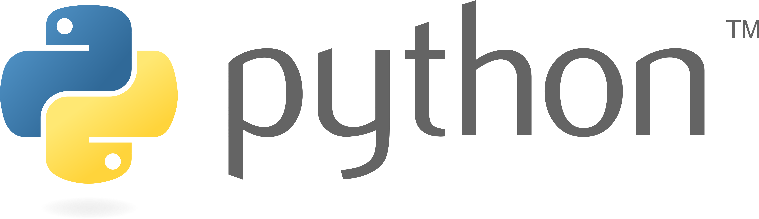
2. Python
Data handling
Practical and scalable usage
Speed comparison

Slide 5
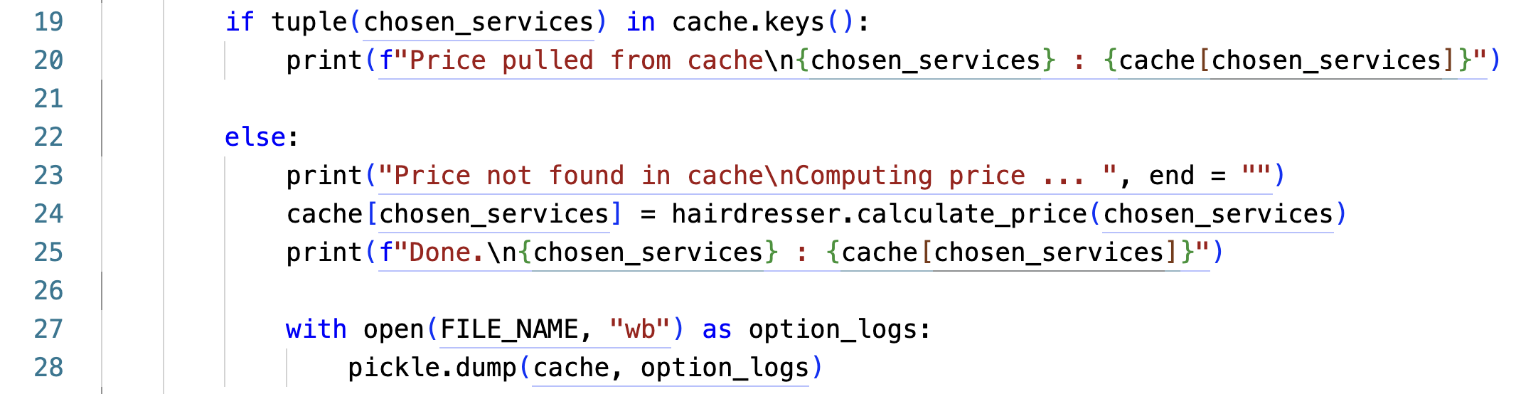
Data handling

Slide 6
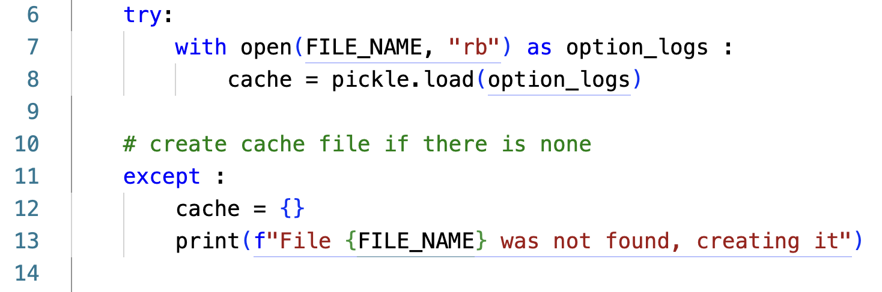
Practical and scalable usage

Slide 7
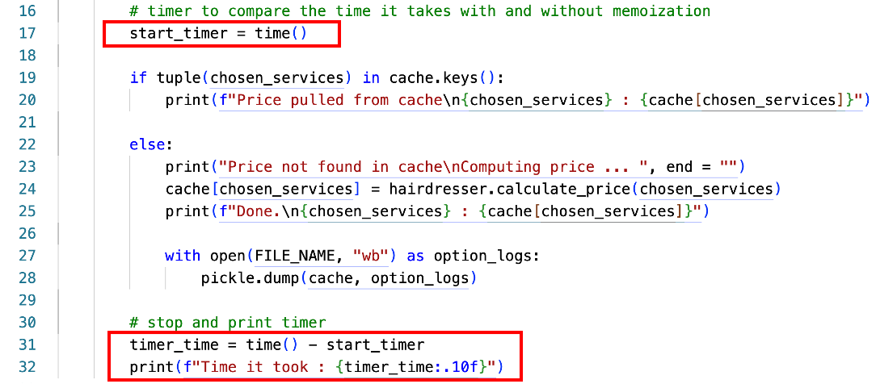
Speed Comparision

Slide 8

3. PhP - Laravel
What is Laravel?
Different caching methods
Code

Slide 9
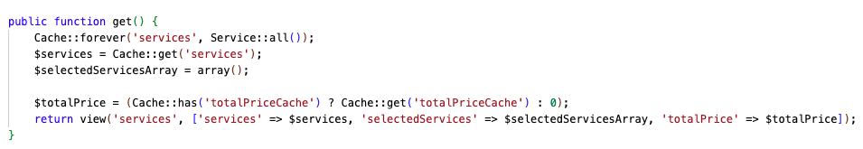
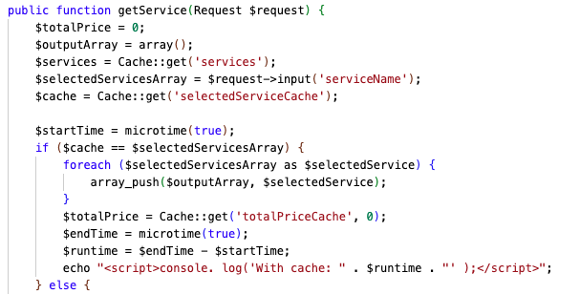

Slide 10
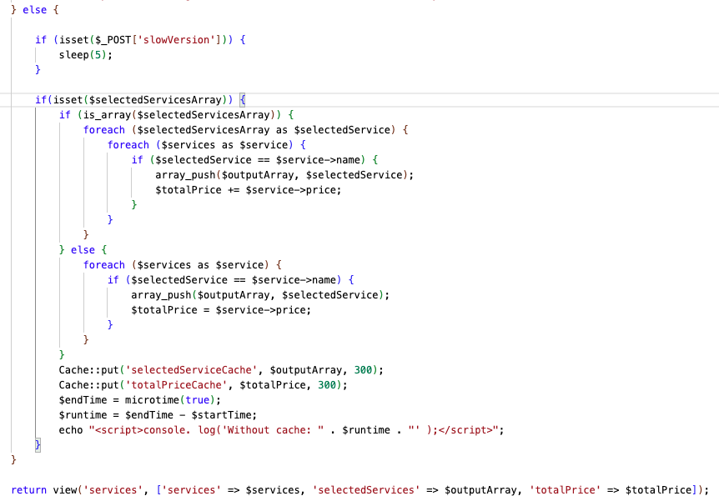

Slide 11
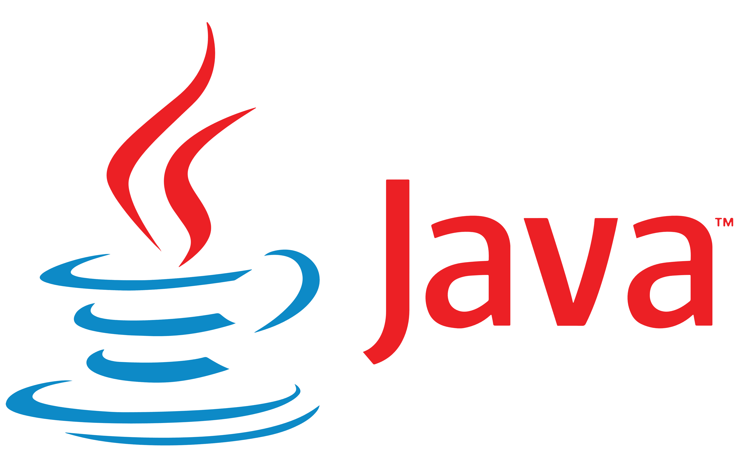
4. Java

Slide 12
5. Conclusion
Saves time
Etc

Slide 13
6. References

